Slide 1



FINAL PROJECT
Group 9
Notes:
Hello everyone! welcome to the final project presentation presented by Group #9.

Slide 2








TEAM MEMBERS
Group 9
Johnny Wang
Jesse Yang
Ariel Zhu
Shampire Wang
Well-known Real Estate Developer
Real Estate Tycoon
Real Estate Super Buyer
Real Estate Potential Customer
Notes:
A brief introduction of the group members for this presentation - Johnny, Jesse, Ariel and Xinpei

Slide 3


Agenda
Topic Selected
Source of Data
Analysis Phases
Technologies, Languages, Tools & Algorithms
Results
Recommendations for Future Analysis
Challenges Met
Notes:
Here is the agenda of our presentation. We will walk through every single one of them in the later explanation.

Slide 4

Part 1
TOPIC SELECTED
GTA Area housing/condo
price prediction
((maybe two similar cities comparison to predict potential crash of the price)
APIs to detect the volume flow in
Area Markdown
Type Markdown
Time Period
Toronto Downtown
Condo
From 2000 to 2021 - Monthly
Notes:
Okay! First of all, what is our project about?

Slide 5

Background
Reasons of Topic Selected
Significance of the Topic
Level of Difficulty and Possibility on Data Collecting
Time Limit on Researching
Degree of Completion Evaluation
Technical Application
Economical: Index of Wealth Level
Individuals: Reference on Buy/Sell Decisions
Government: A Tool to Control Real Estate Market
Notes:
What you see here is Toronto, one of the largest and most prosperous cities in the world. A big portion of the economy of this city is real estate and I wanna give you a brief taste how crazy the market is in this place.

Slide 6
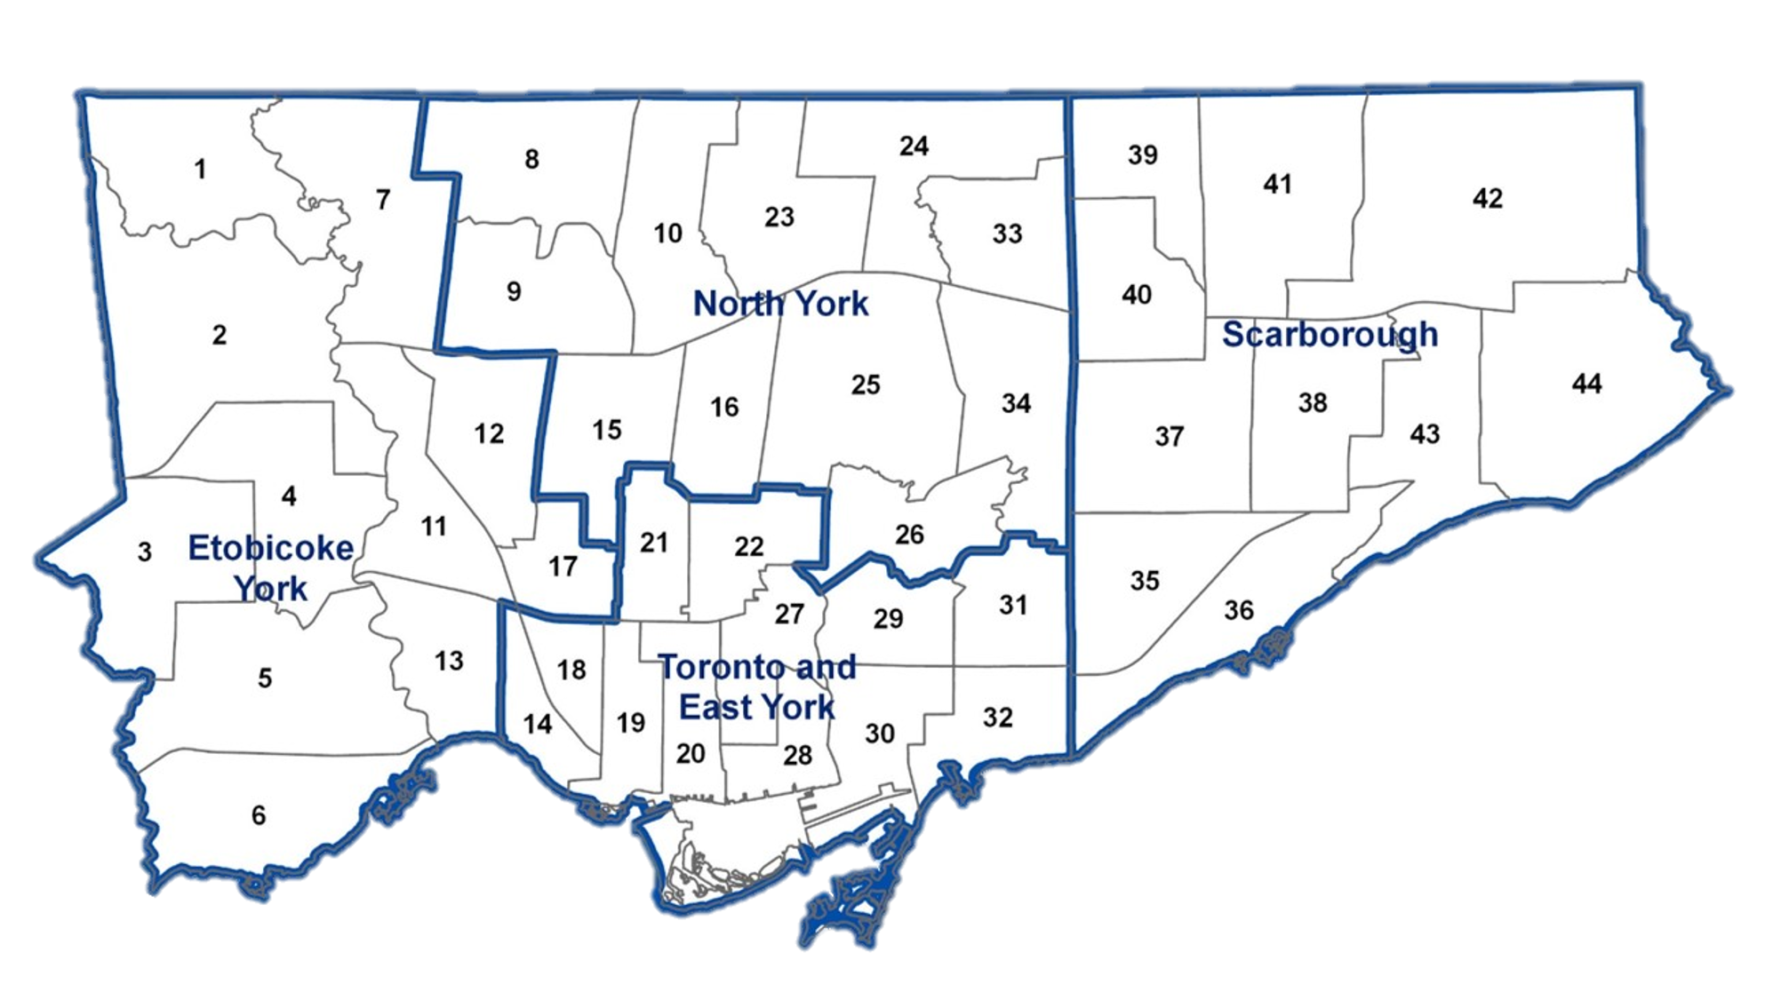

Condo Unit
Year 2000: $200k
→
Year 2020:
2M
Notes:
For people might be familiar in City of Toronto, it is splitted into different areas. For certain area, I want to emphasize the data here is for certain area, in year 2000, the average price of a condo unit is 200k $. But when it comes to year 2020 before the pandemic, guess what… the average price of a condo unit sale in that area is around 2M$. That is ten time of the worth!

Slide 7


Sell???
Buy in???
Price in the future???
Notes:
Okay! it appears that condo selling has shown a great potential to be a wise investment option and everyone seems happy! But here comes the question… for a single buyer real estate is not something that if you keep holding it forever then the value will simply keep increasing. Instead, the value fluctuates as the economic environment changes. Now the question becomes… when should I buy in? when should I sell it? What does the sale pricing look like in the near future?

Slide 8


Problem Statement
Scope
of the
Project
Problem
Statement
Final
Goal
Toronto
Real Estate
Average Price Forecasting
Time:2000 to 2021
Zone: Downtown Area
Type: Condo
Forecaster the Trend on
Condo Price
in Toronto Downtown Area

Slide 9

Part 2
DATA & MODEL
Data Pipeline
Modelling
Analysis
Notes:
Now I will talk about how we predict the condo price using the magic --- data and a statistical model.

Slide 10
DATA PIPELINE
Data Sources
Data ETL
Storage
Feature Engineering
Analytics
Delivery
NGO
Government
Public database
Example:
Statistic Canada
World Bank
Data Cleaning
Data Integration
Server
Feature Extraction
Feature Selection
Feature Modification
Build models
Cross-Evaluation
Webpage
Interactivity
Visualization
Notes:
In order to predict the condo price, we used data analytics. We followed this data pipeline, where we started by finding data sources. Then, we cleaned and transformed the data and stored the data in a server. This is followed by feature engineering. Next, we built the model, evaluated the model, and generated the forecast, which was then delivered to the end user in an interactive webpage.

Slide 11
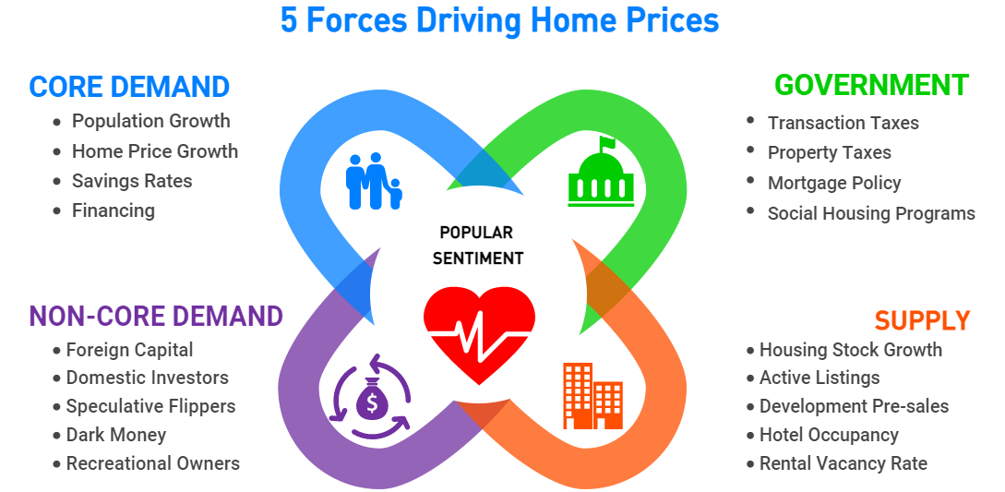
FACTORS THAT AFFECT
REAL ESTATE PRICES
Notes:
The first thing we did was doing research about what can impact the real estate prices so that we know what data we need to collect.

Slide 12
FACTORS THAT AFFECT REAL ESTATE PRICES
Indicators/factors:
Bank Prime Rate
Gold Price
NASDAQ Index
Toronto Population
Ontario Immigration
University of Toronto Total Enrolment
Unemployment Rate
New Condo planed for Construction
New Condo Completed
Total Sales
Target:
Average Price (Monthly)
Notes:
Here are some examples of the factors or indicators that we think are important to the forecast.

Slide 13
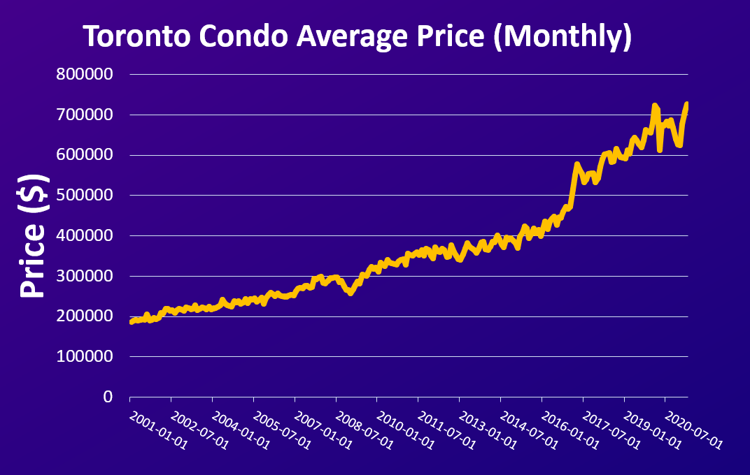

Building Models
A continuous number
Multivariate
Time Series
Small data size
Notes:
After cleaning and transforming the data, we want to build a model. Here is what the data looks like from 2001 to now. There are a few characteristics worth mentioning. First, price is a continuous number. Secondly, there are multiple variables that can affect the price and those variables are likely to have relationships among themselves. Thirdly, this is a time series.

Slide 14
VECTOR AUTOREGRESSIVE (VAR) MODEL
Statistical Model:
Captures the relationship between multiple quantities as they change over time
Stochastic process model
Less demanding in information
Notes:
Based on these characteristics, we chose a model called vector autoregressive model.

Slide 15
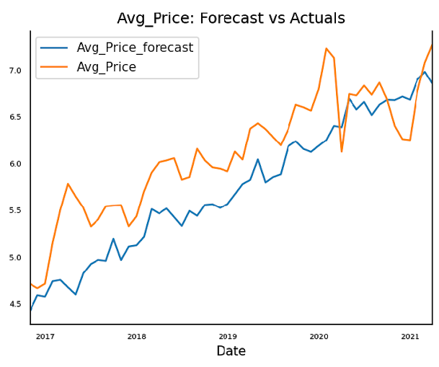
FORECAST VS. ACTUALS
Notes:
Here is a graph we generated when testing our model. The test data is from 2017 to 2021. As you can see, the forecast is very close to the actual prices. Most of the turning points are accurately predicted, but I guess the model didn’t see COVID coming.

Slide 16
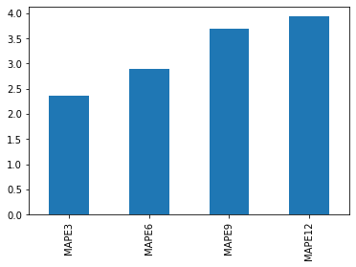
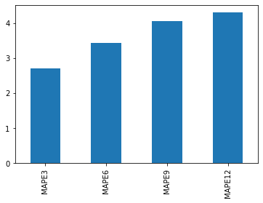
FORECAST VS. ACTUALS
Testing set: 2018-05-01 to 2019-04-01
Testing set: 2018-09-01 to 2019-08-01
Error %
Error %
Notes:
Using two sets of rolling window cross evaluation, we concluded that for a 3 month forecast, the average error of the forecast is around 2.5%. For a 12 month forecast, the error is around 4%. The error will get larger as you predict farther away from the current time. But we think the result is reasonable, given the instability of the real estate market.

Slide 17
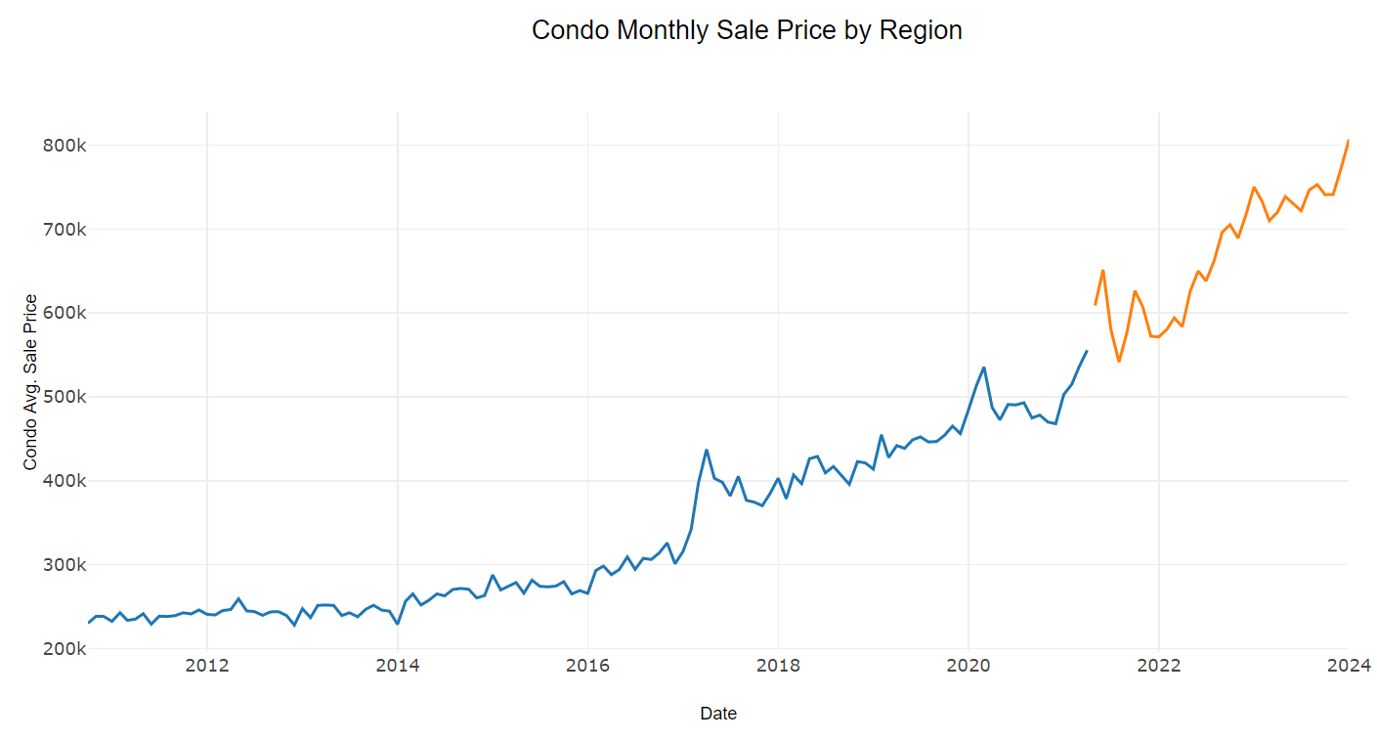
HISTORICAL + FORECAST
PREDICTION
HISTORICAL DATA
Notes:
This is the final forecast we produced from the model. We are confident that our model is pretty accurate, at least for the first 12 months, but really how accurate it is, only time will tell. Now, let’s take a look at the webpage we built.

Slide 18

Part 3
Analysis Phases
Model Building
Selection of Model
Description of VAR
Model Evaluation

Slide 19
Model Selection
Nature of the problem
Time Series
Different trails
Pros & Cons

Slide 20


Part 4
Technologies, Languages, Tools & Algorithms
Description of VAR:
What is VAR
Importance parameters
Adjustment process
Model evaluation:
Evaluation Method
Results
Forecast showcase

Slide 21
Part 5
Results
Website URL:
Instruction on our website using
Tools available on our website
Analysis results publishment
Notes:
Next, I will explain to you the map display section as a potential consumer. For example, suppose you bought a property in the C01 area 10 years ago. Now you are planning to sell the previous condo. You want to evaluate your investment in this condo trading. However, you forgot the last purchase price, so you may hope to refer to the same area Historical condo prices for evaluating the historical cost on this property. In this case, you can choose "historical" in the filter on the left side of our webpage and then select the time you bought the property, such as May 2015. We can get the historical average condo prices in all areas on the map by this way. Then, finding and clicking the C01 area on the map, and you could see the information needed.
In the same way, we can similarly get the latest housing prices. But considering our property will be traded in the next month, you need the possible future price instead. So we can choose to forecast and set the time for next month. Then select this area again. As a result, our machine learning model will use historical data to help you predict the approximate price of the following month in this area.
If you don't like the map mode, you could customize the mapping interface choose the layer by clicking the right top of the map.

Slide 22
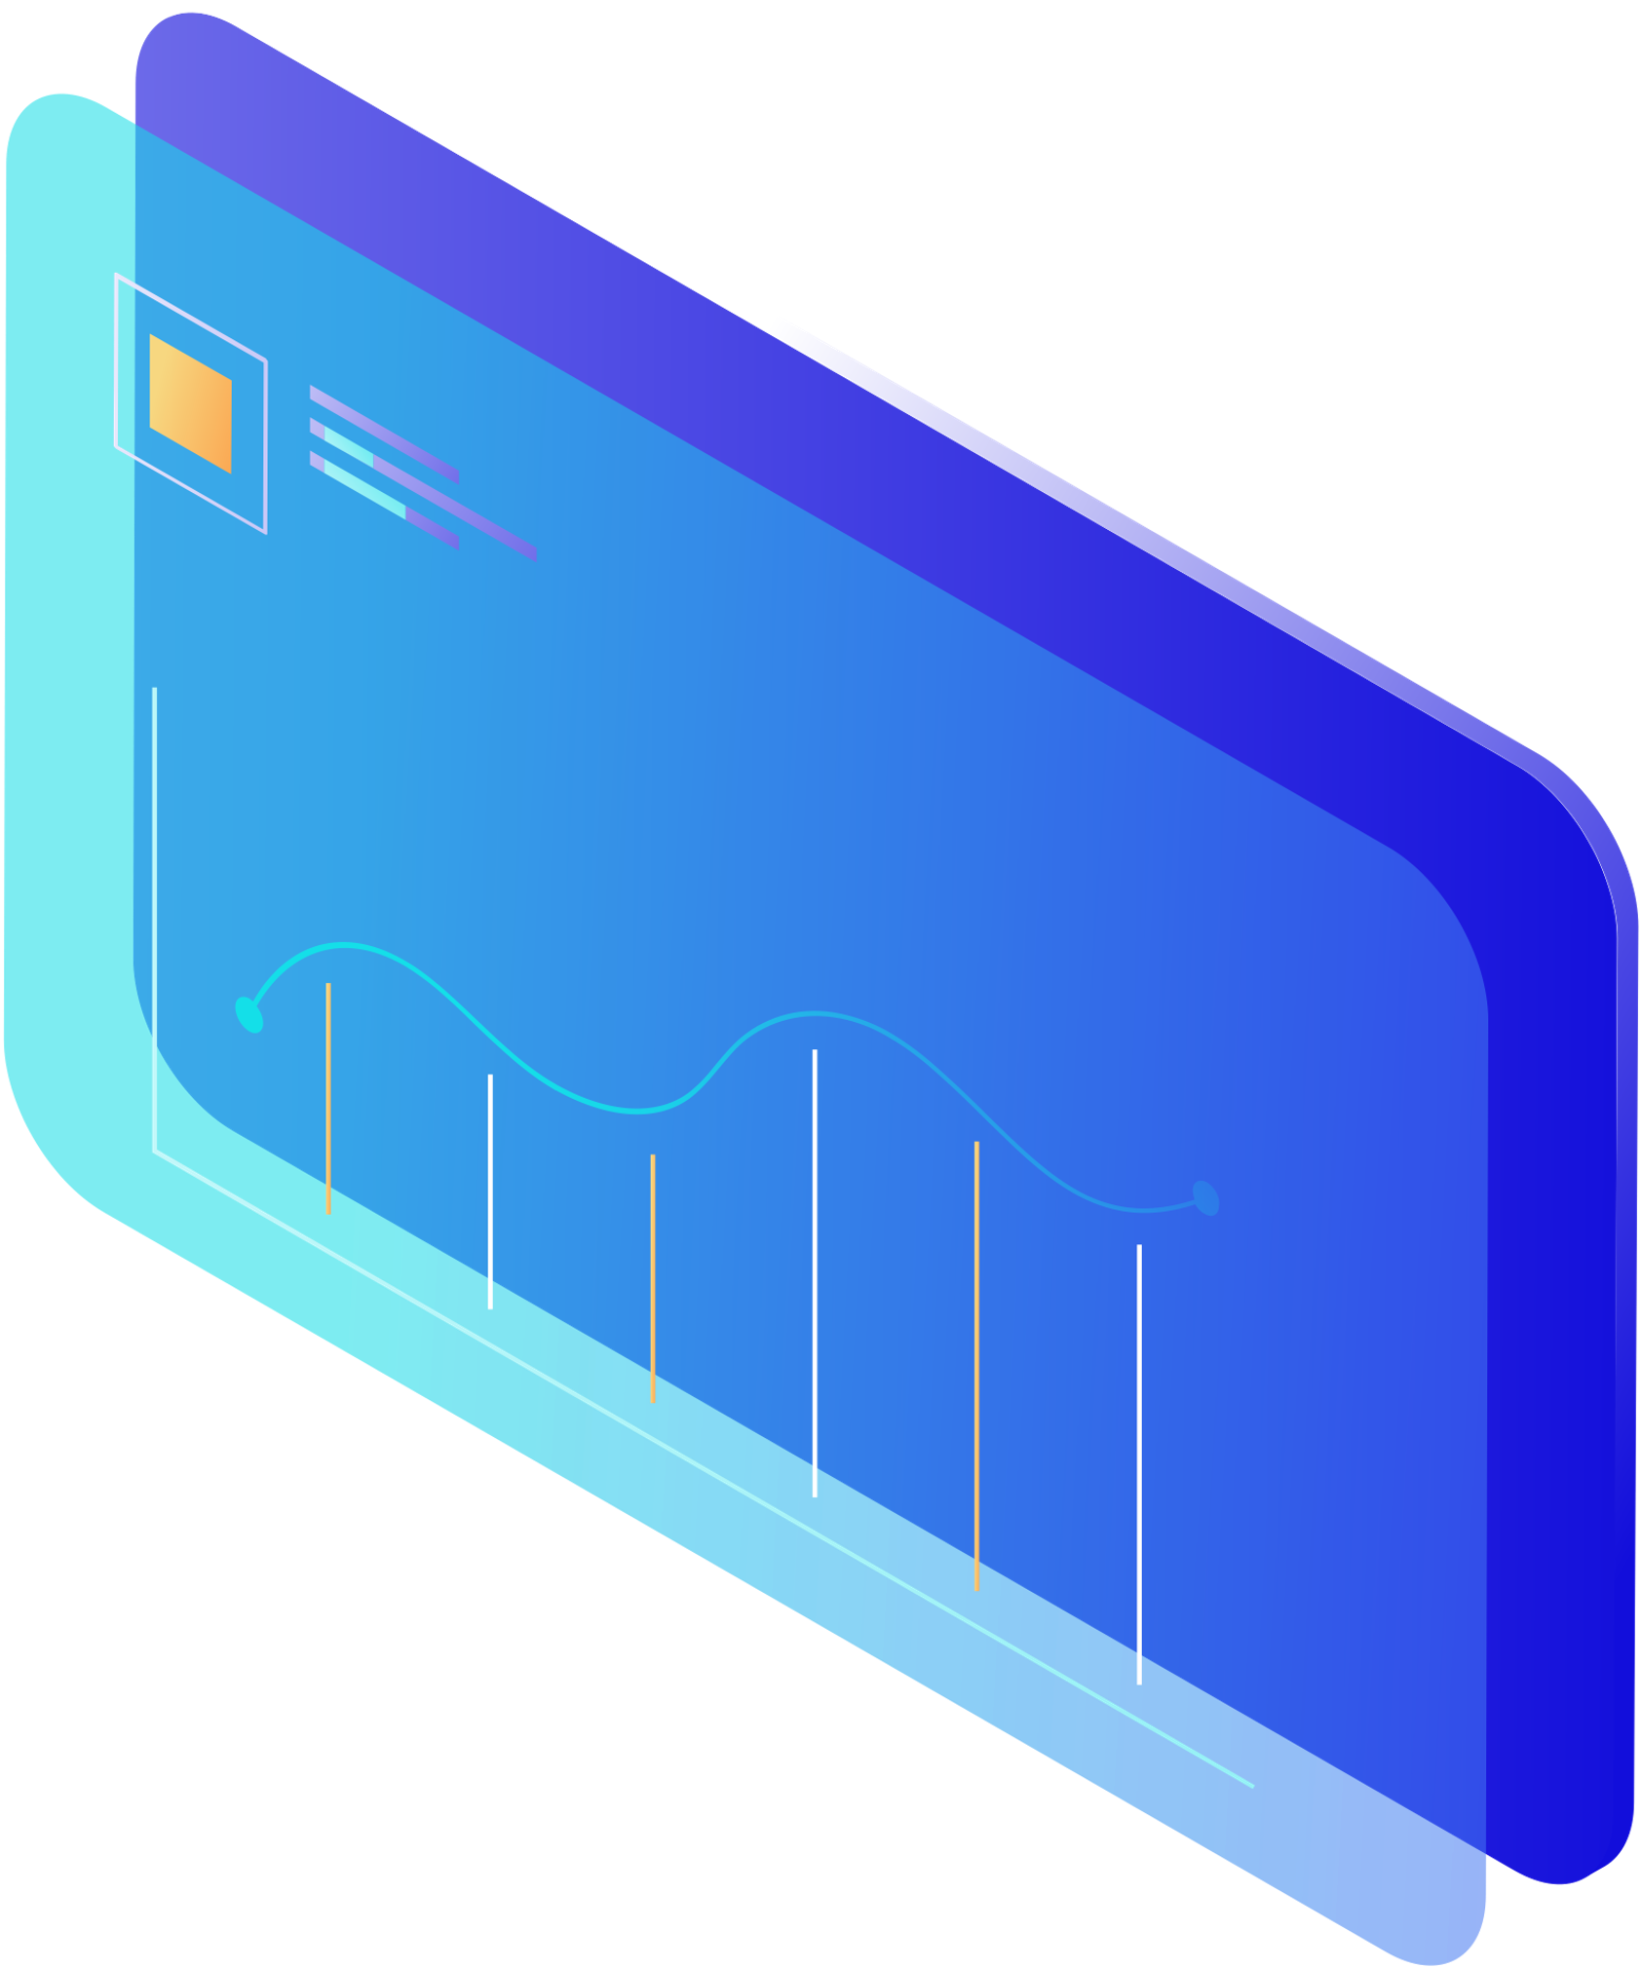



Part 6
Recommendations for Future Analysis & Potential Changes
Look for data collection with better quality
Explore more related factors
Create a database for collecting future data
Notes:
This webpage demonstrates what we have already achieved for this project. To work on this project further, we would need to look for better data sources, probably paid ones, so that we may have more accurate results and more insights from the data.
（开会啦:D）Second thing is, if we want better informed analysis and more detailed information for each specific region, we shall also dig through more factors and find those that also have an impact on property price.
Another problem we faced was the limited number of data entries for the analysis, more rows of data fed into the model will be helpful for future analysis, and a database is needed for continuous collection of incoming data.
With those improvements, we may aim to forecast prices for smaller regions and for a higher frequency.

Slide 24
Thanks
FOR WATCHING

